Slide 1
Microbiology

Slide 2
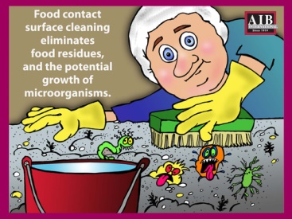
Food Contact Surface Cleaning
Food contact surface cleaning eliminates food residues and the potential growth of microorganisms.

Slide 3
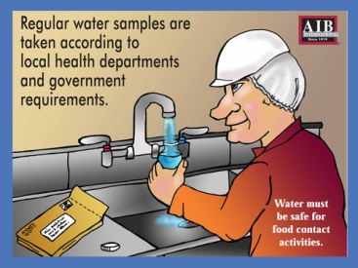
Water Samples
Regular water samples are taken according to local health departments and government requirements

Slide 4
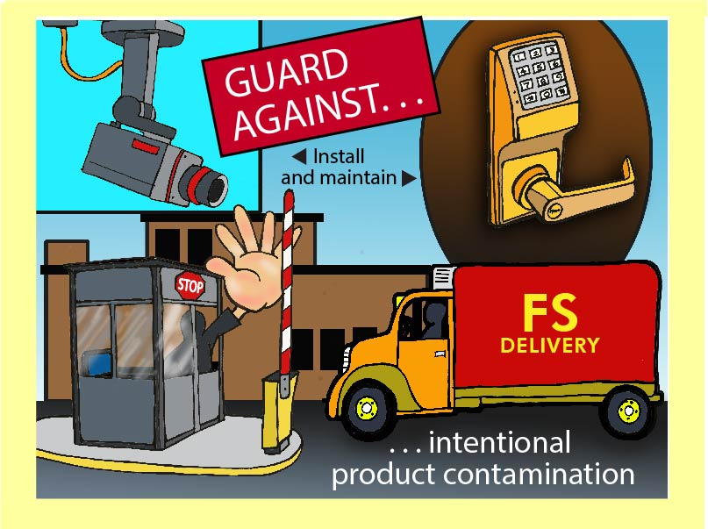
Guard Against Product Contamination
Install and maintain security to guard against intentional product contamination.

Slide 5
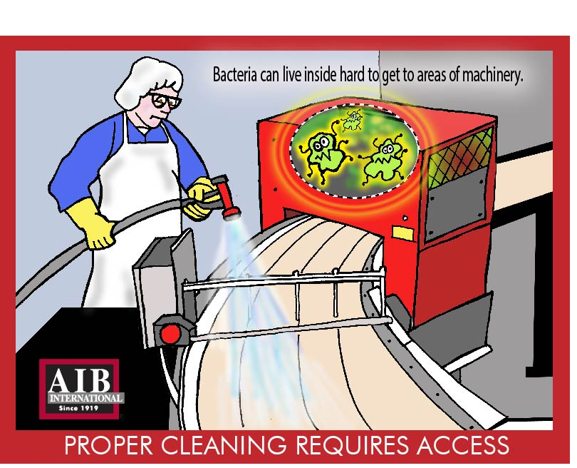
Proper Cleaning
Proper cleaning requires access. Bacteria clan live inside hard to get to areas of machinery.

Slide 6
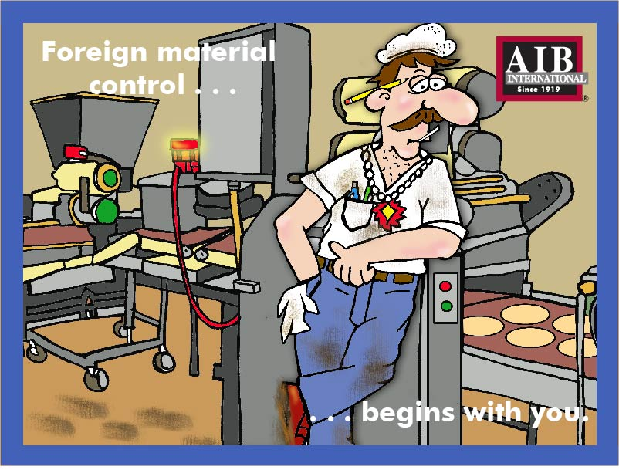
Foreign Material Control
Foreign material control begins with you

Slide 7
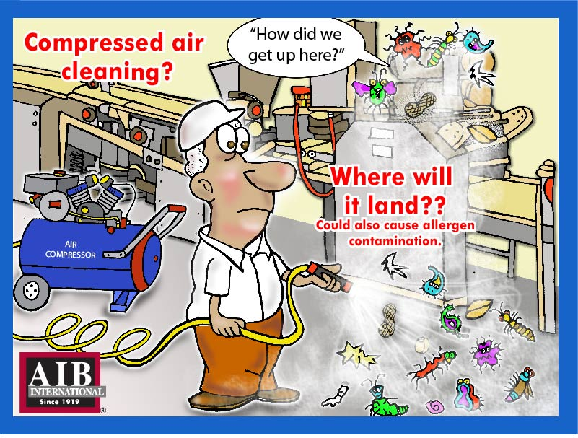
Compressed Air Cleaning
Compressed air cleaning could also cause allergen contamination.

Slide 8
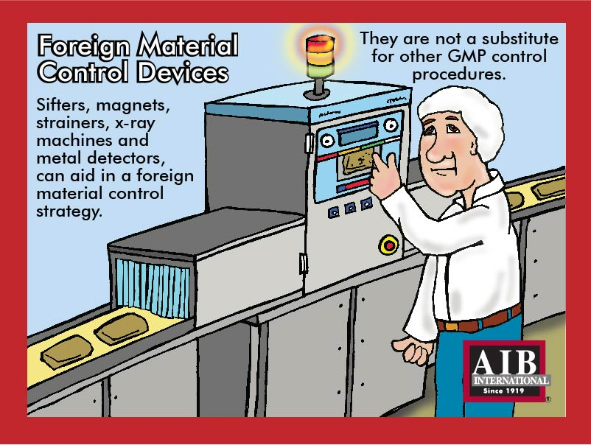
Foreign Material Control Devices
Sifters, magnets, strainers, x-ray machines and metal detectors can aid in foreign material control strategy. They are not a substitute for other GMP control procedures.

Slide 9
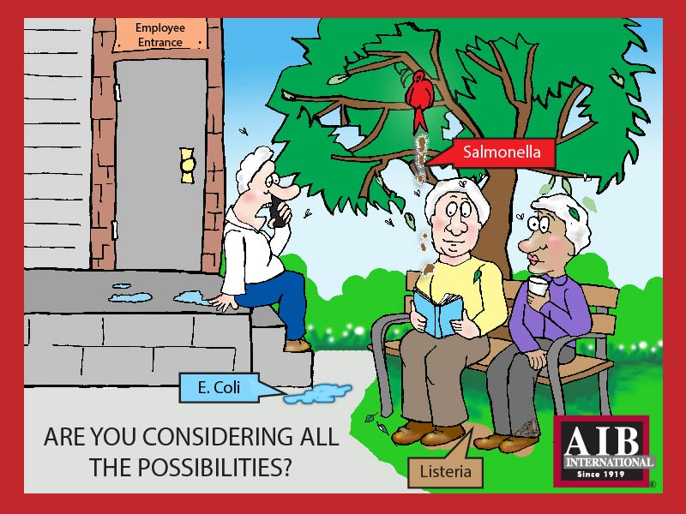
Contaminations
Are you considering all the possibilities?

Slide 10
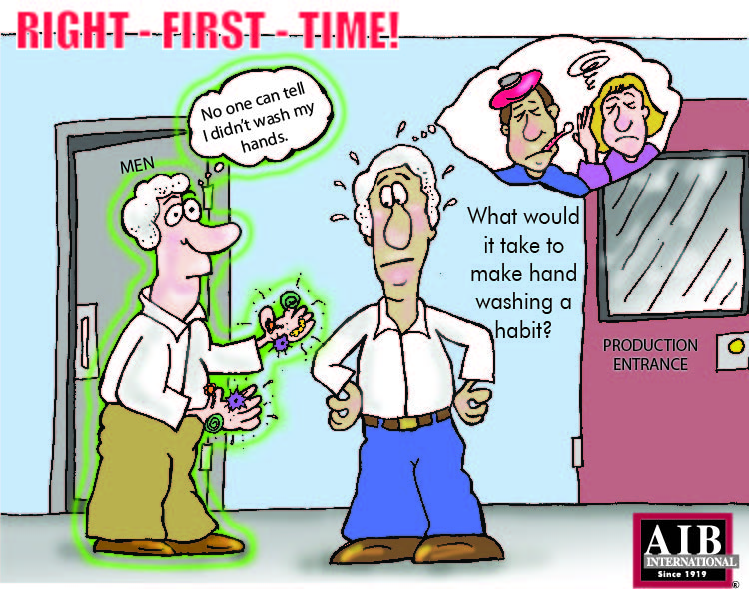
Hand Washing
Get it right the first time! Proper hand washing should be habit.

Slide 11
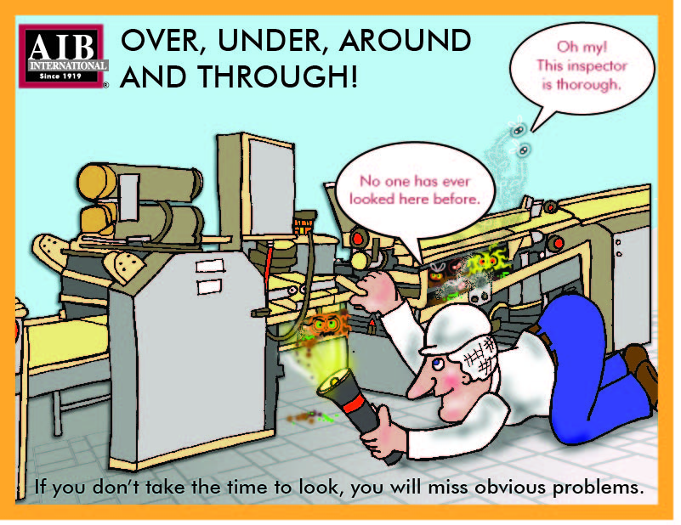
Be Thorough
Over, under, around and through. If you don't take the time to look, you will miss obvious problems.

