Slide 1
Maintenance

Slide 2
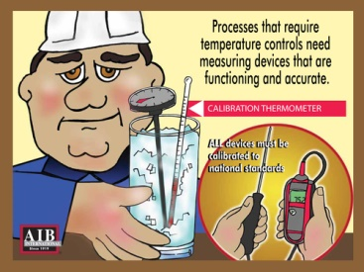
Calibrate Temperature Controls
Processes that require temperature controls need measuring devices that are functioning and accurate. All devices must be calibrated to national standards.

Slide 3
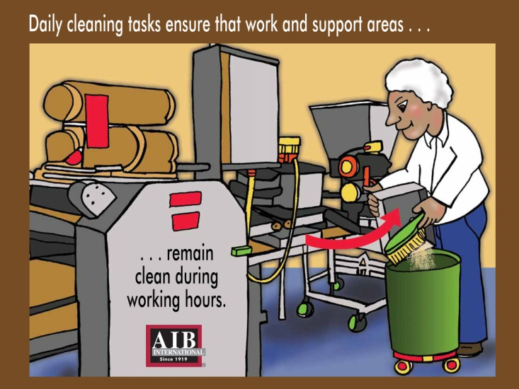
Daily Cleaning
Daily cleaning tasks ensure that work and support areas remain clean during working hours

Slide 4
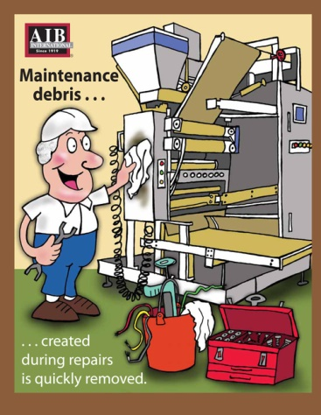
Maintenance Debris
Maintenance debris created during repairs is quickly removed.

Slide 5
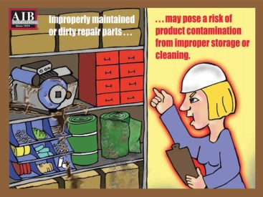
Maintaining Equipment
Improperly maintained or dirty repair parts may pose a risk of product contamination from improper storage or cleaning.

Slide 6
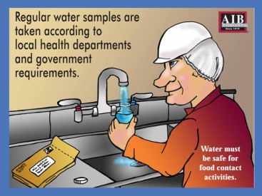
Water Samples
Regular water samples are taken according to local health departments and government requirements.

Slide 7
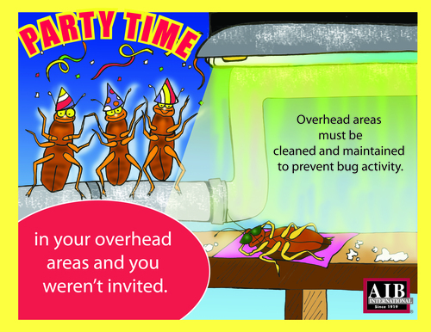
Overhead Cleaning
Overhead areas must be cleaned frequently to prevent bug activity.

Slide 8
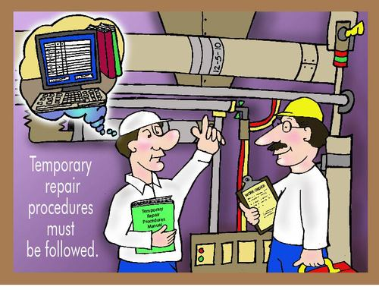
Temporary Repairs
Temporary repairs must be followed.

Slide 9
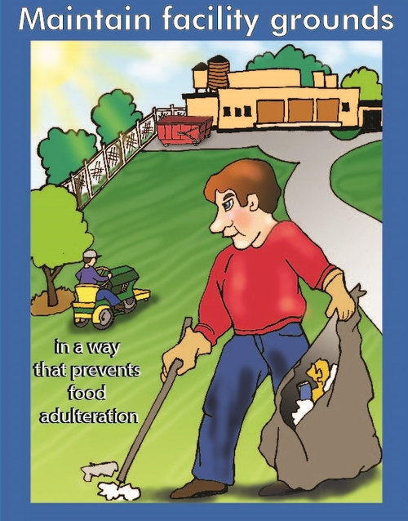
Maintain Facility Grounds
Maintain facility grounds in a way that prevents food adulteration.

Slide 10
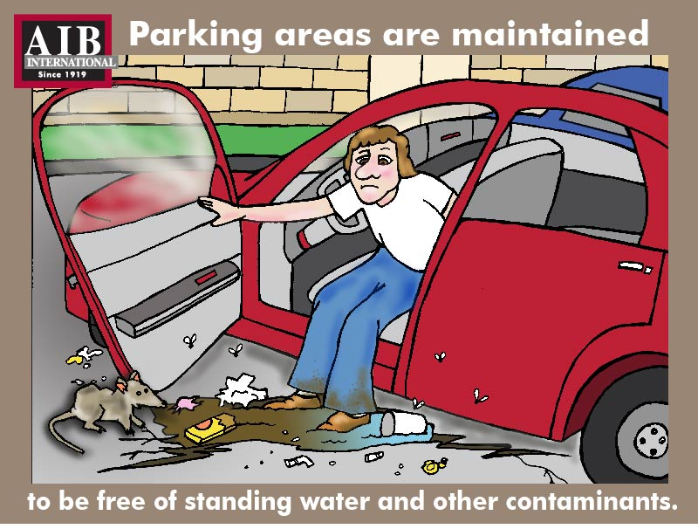
Parking Lot Maintains
Parking areas need to be maintained to be free of standing water and other contaminants.

Slide 11
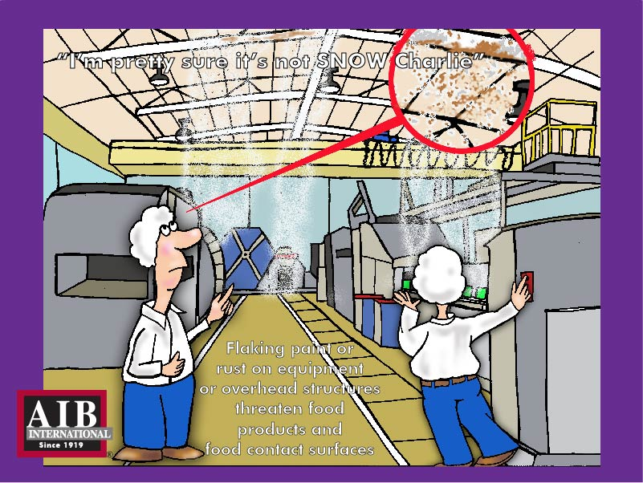
Paint and Rust
Flaking paint or rust on equipment or overhead structures threaten food products and food contact surfaces.

Slide 12
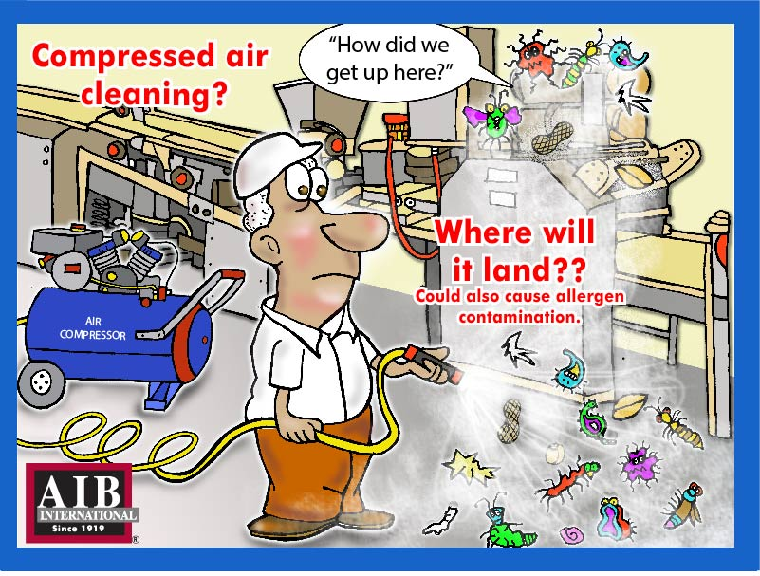
Compressed Air Cleaning
Compressed air cleaning could also cause allergen contamination

Slide 13
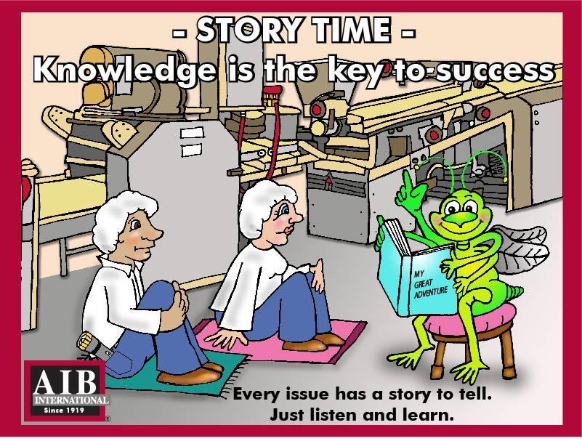
Knowledge is the Key to Success
Every issue has a story to tell. Just listen and learn.

Slide 14
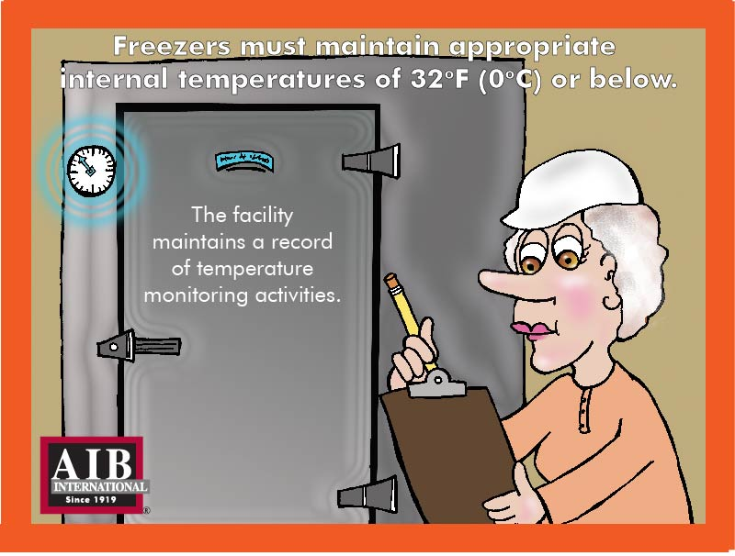
Freezers
Freezers must maintain appropriate internal temperatures of 32 degrees F (0 degrees C) or below. The facility maintains a record of temperature maintaining activities.

Slide 15
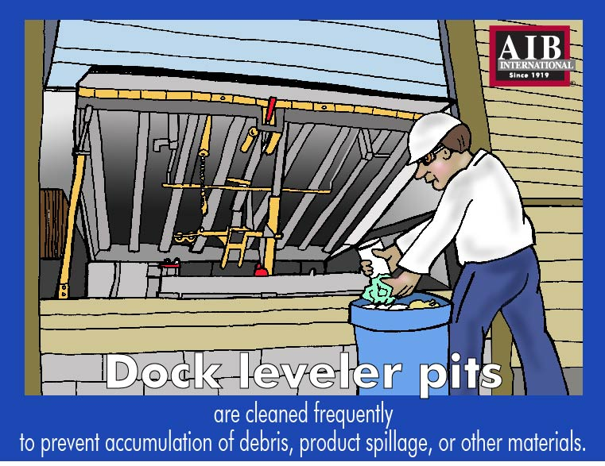
Dock Lever Pits
Dock lever pits are cleaned frequently to prevent accumulation of debris, product spillage, or other materials.

Slide 16
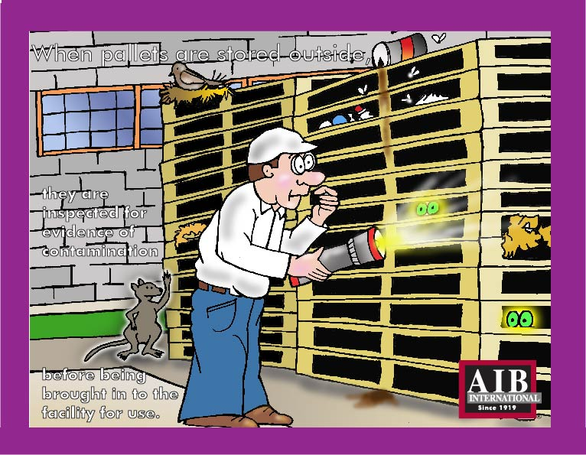
Outside Pallet Storage
When pallets are sorted outside, they are inspected for evidence of contamination before being brought into the facility for use.

Slide 17
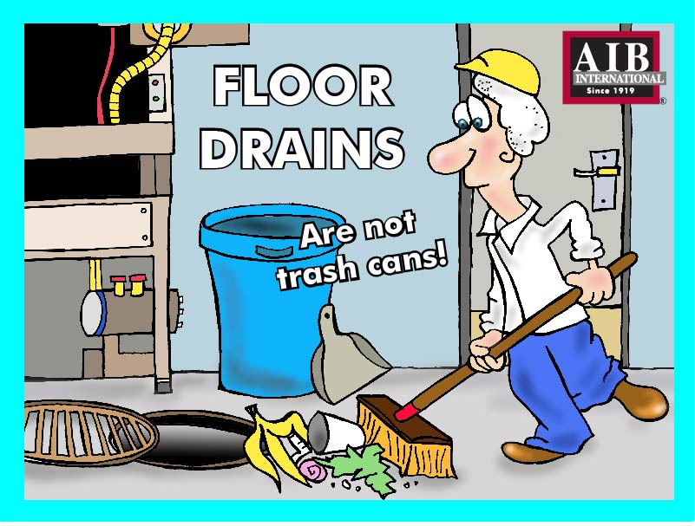
Floor Drains
Floor drains are not trash cans.

Slide 18
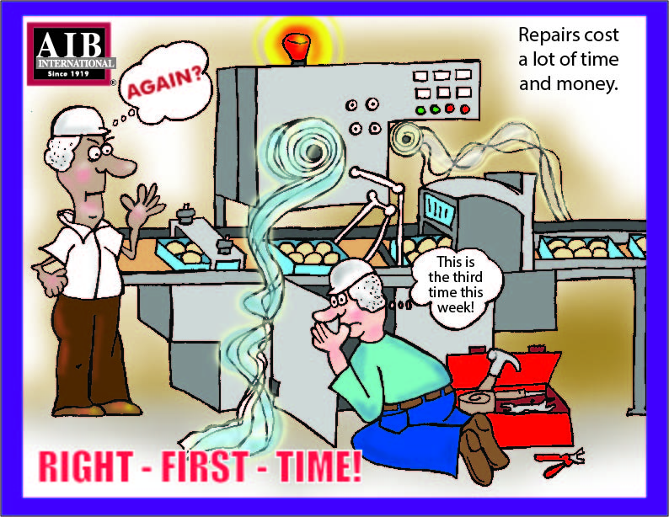
Right the First Time
Repairs cost a lot of time and money.

Slide 19
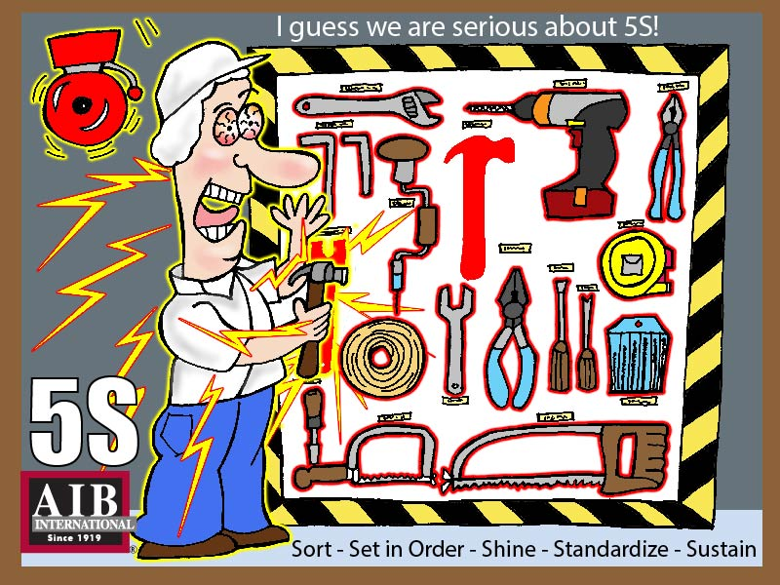
Sort. Set in order. Shine. Standardize. Sustain.

Slide 20
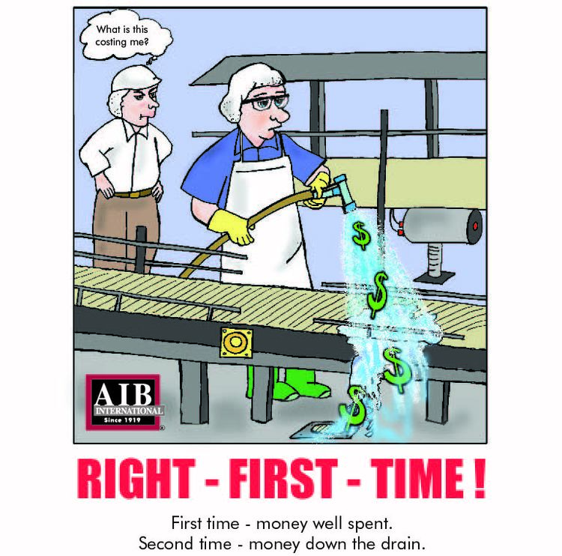
Get it Right the First Time
First time - money well spent.
Second time- money down the drain.

Slide 21
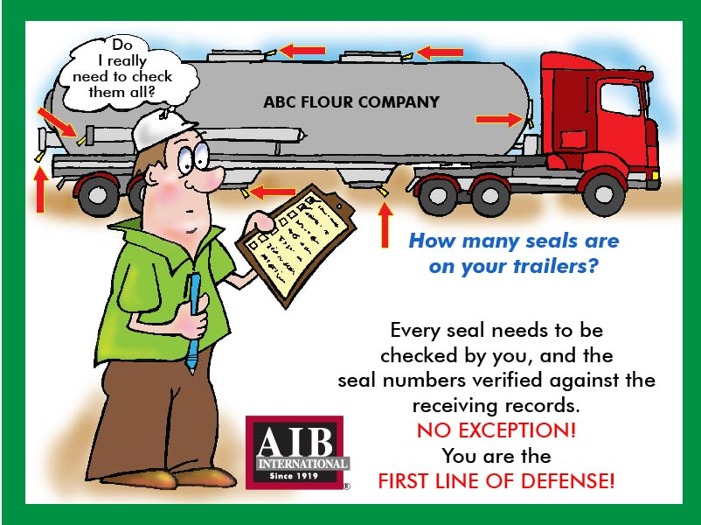
Trailer Seals
How many seals are on your trailers? Every seal needs to be checked by you, and the seal numbers verified against the receiving records. NO EXCEPTION! You are the first line of defense.

Slide 22
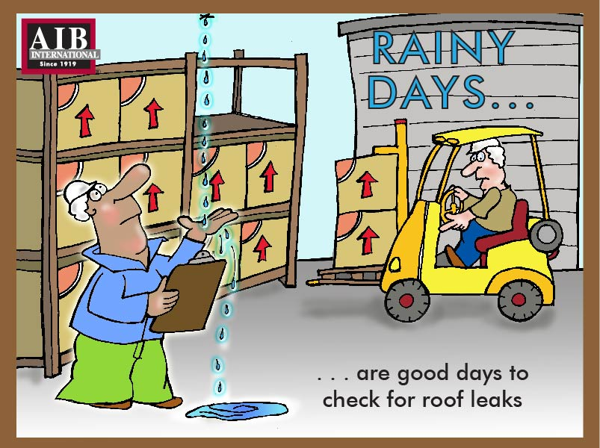
Rainy Days
Rainy days are good days to check for roof leaks.

