Slide 1
Food Safety

Slide 2
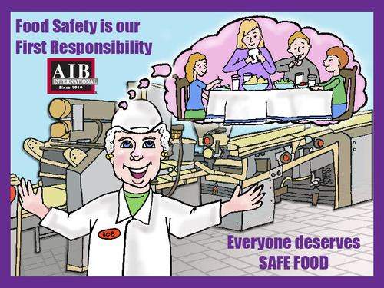
Food Safety Responsibility
Food safety is our first responsibility. Everyone deserves safe food.

Slide 3
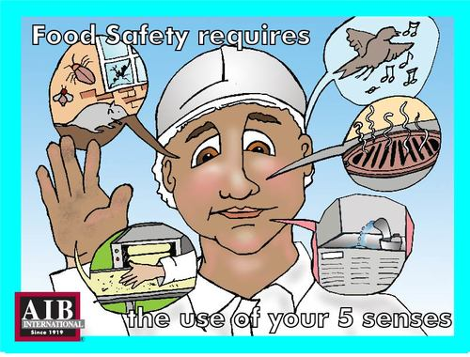
Food Safety
Food safety requires the use of your 5 senses.

Slide 4
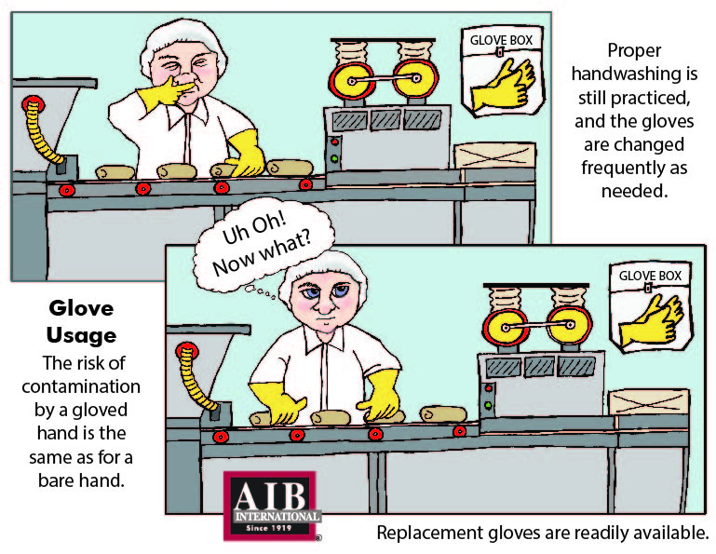
Glove Usage
The risk of contamination by a gloved hand is the same as for a bare hand. Proper hand-washing is still practiced, and the gloves are changed as frequently as needed.

Slide 5
Contaminations
Are you considering all the possibilities?

Slide 6
Product Loading
Protect your products from weather damage and possible contamination. Finished products are loaded or transferred in covered bays or canopies.

Slide 7
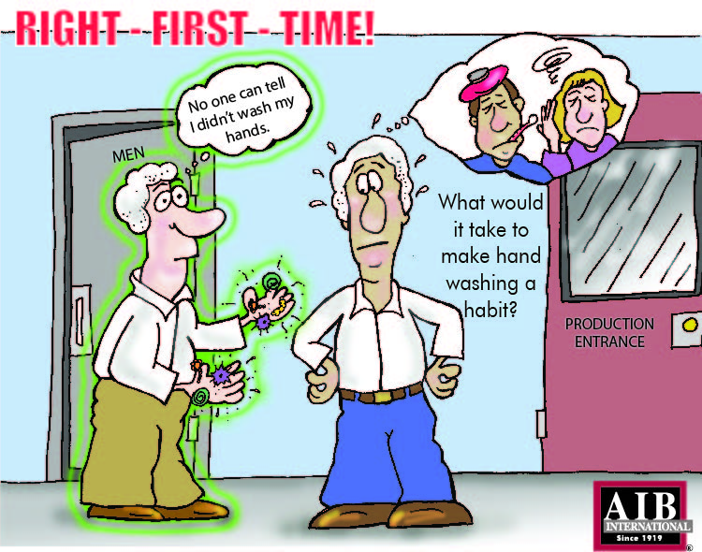
Hand Washing
Get it right the first time! Proper hand washing should be habit.

