Slide 1
Facilities

Slide 2
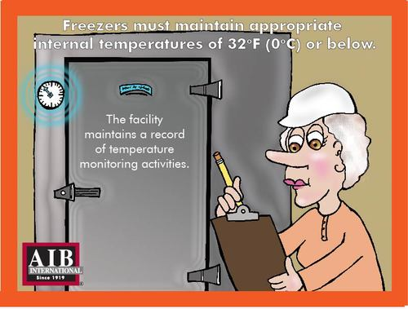
Freezers
Notes:
Freezers must maintain appropriate internal temperatures of 32 degrees F (0 degrees C) or below. The facility maintains a record of temperature maintaining activities.

Slide 3
Dock Lever Pits
Notes:
Dock lever pits are cleaned frequently to prevent accumulation of debris, product spillage, or other materials.

Slide 4
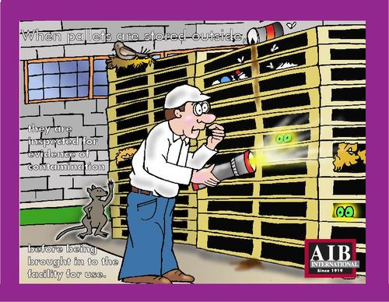
Outside Pallet Storage
Notes:
When pallets are sorted outside, they are inspected for evidence of contamination before being brought into the facility for use.

Slide 5
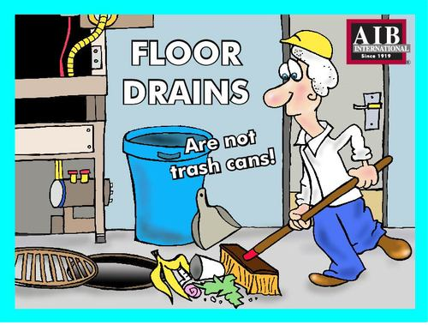
Floor Drains
Notes:
Floor drains are not trash cans.

Slide 6
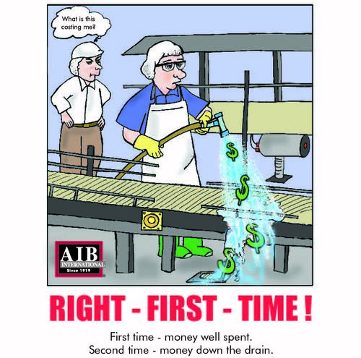
Get it Right the First Time
Notes:
First time - money well spent.
Second time- money down the drain.

Slide 7
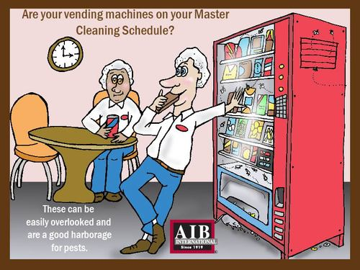
Vending Machines
Notes:
Are your vending machines on your Master Cleaning Schedule? They can be easily overlooked and are a good harborage for pests.

Slide 8
Product Loading
Notes:
Protect your products from weather damage and possible contamination. Finished products are loaded or transferred in covered bays or canopies.

Slide 9
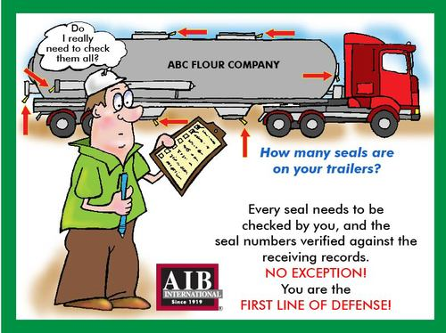
Trailer Seals
Notes:
How many seals are on your trailers?
Every seal needs to be checked by you, and the seal numbers verified against the receiving records. NO EXCEPTION! You are the first line of defense.

Slide 10
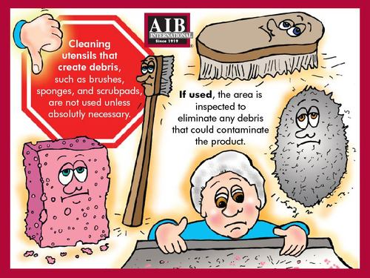
Trailer Seals
Notes:
Cleaning utensils that create debris, such as brushes, sponges, and scrub pads are not used unless absolutely necessary.

Slide 11
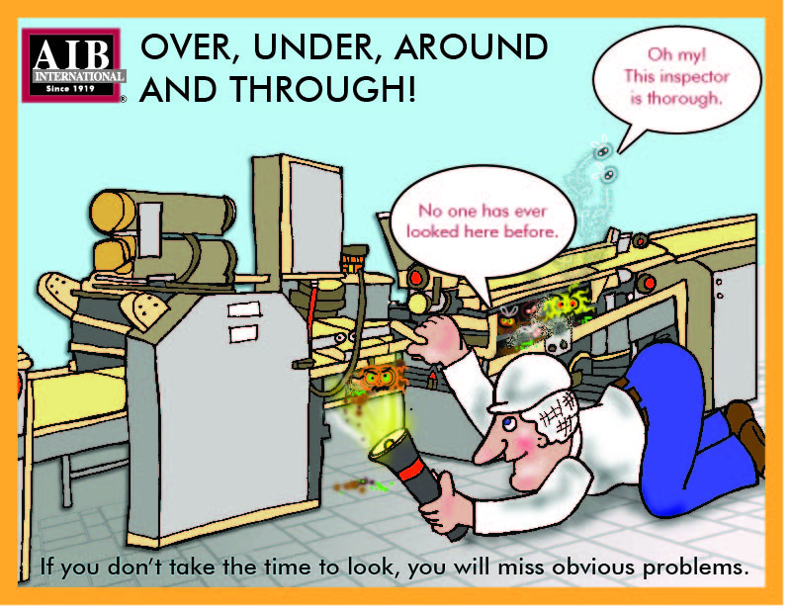
Be Thorough
Notes:
Over, under, around and through. If you don't take the time to look, you will miss obvious problems.

Slide 12
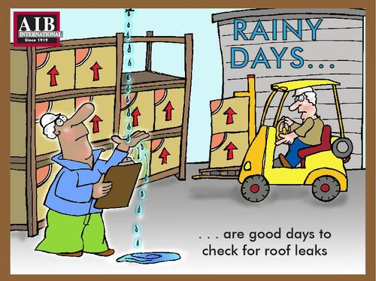
Rainy Days
Rainy days are good days to check for roof leaks.

