Slide 1
CHEMICALS

Slide 2
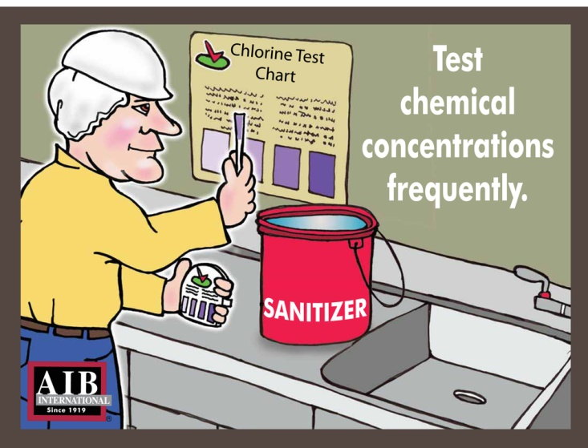
Concentration Tests Test chemical concentrations frequently

