Slide 1
allergens

Slide 2
Transporting Equipment
Notes:
Transporting equipment may introduce cross contamination issues if they are not maintained

Slide 3
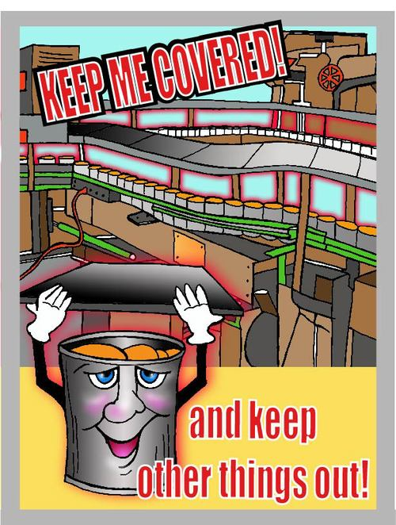
Covering Containers
Keep storage containers covered to keep unwanted materials out.

Slide 4
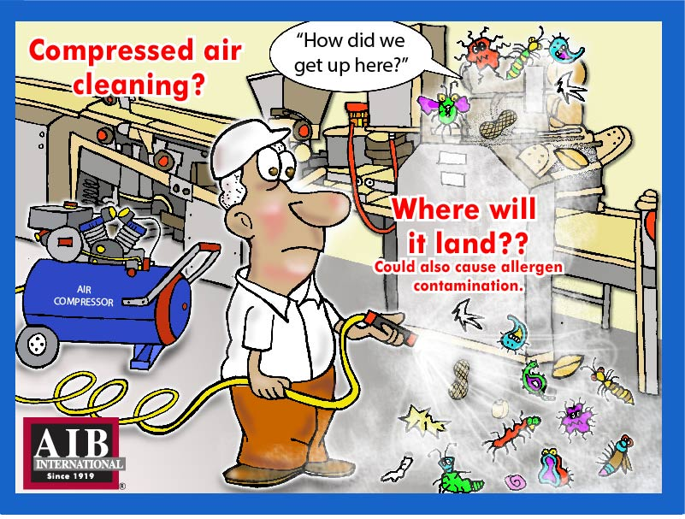
Compressed Air Cleaning
Compressed air cleaning could also cause allergen contamination.

Slide 5
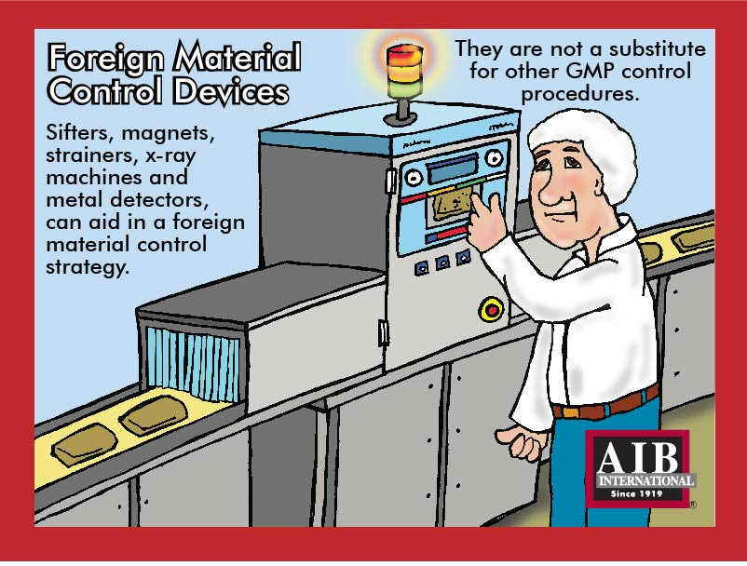
Foreign Material Control Devices
Sifters, magnets, strainers, x-ray machines and metal detectors can aid in foreign material control strategy. They are not a substitute for other GMP control procedures.

Slide 6
No personal items in the production area
Personal Items

